Slide 1
How Students Experience the Core Curriculum
Elizabeth Mastilak, Colleen Malloy, Hanh Nguyen,
Levi Sayles, Aaryan Bhatta, Sawyer Hurley,
Stephen Klayer, Alex Peinkofer, Rocco Roman
Dr. David Gerberry

Slide 2
Outline
Investigate aspects of how students experience the core
Timing of the core
Second language requirement
Transfer credits for core requirements
Grades earned in core classes
Overlap of core and major requirements
Subpopulations for comparison
NF vs. NT, by major groupings, those who changed majors

Slide 3
The Data
Enrollments of students in courses that fulfill one or more core requirements
Does not include major classes
263,608 instances of enrollment
Cohorts: Fall 2015 – Fall 2023
Variables:
Randomized Student ID
Cohort Year
Cohort Code (NF, NT, etc)
Major, Degree
Term and Semester Number at XU
Course and Grade
Which requirement(s) the course fulfills

Slide 4
Timing
When do students take their core classes?
How does the timing differ between groups of similar majors?
What classes are taken during the summer?

Slide 5
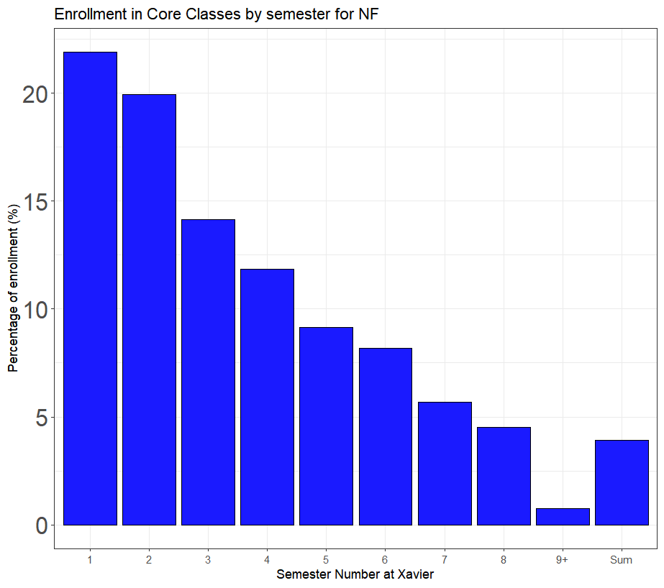

When do students take their core classes?
Plot for New Freshmen (NF)
9+ all semesters after 4 years at Xavier
Steady decline in enrollments
Notes:
No at xavier
Percentage of enrollment
Add findings/ what you want to say

Slide 6
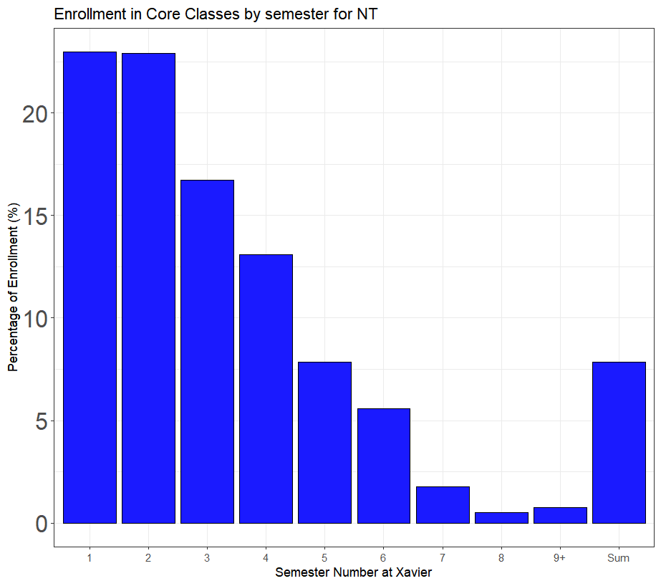
When do students take their core classes?
Plot for New Transfers (NT)
Still a decline, more dramatic
Larger percentage of core enrollments in Summer
Notes:
No at xavier
Percentage of enrollment
Add findings/ what you want to say

Slide 7
Timing of Individual Core Requirements
We chose to make boxplots instead of barplots
Barplots would be too cluttered
Boxplots allow for easier comparison
The summer data was taken out
Difficult to determine a semester value for summer data
Summer courses are unique
Summer courses addressed later

Slide 8
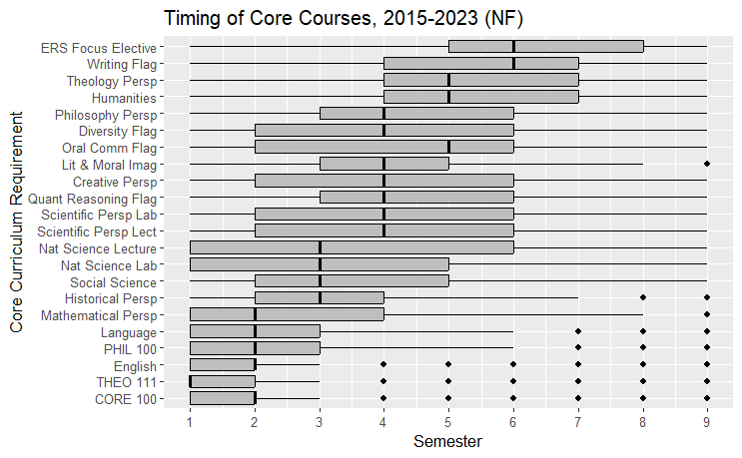
Timing of Enrollment in Core Courses for NF
Little variation in CORE 100, THEO 111, and English
Most students complete a majority of their courses before Senior year
Notes:
* Change color of graph

Slide 9
How does timing differ between majors?
Our groupings of similar majors, done to make visual comparisons
Data only includes one major per student
STEM: MACS, BIOC, BSFB, BIOL, BIMS, BIOP, CHEM, CSCI, DSCI, ENPH, ENVS, MATH, PHYS
Humanities/Social Sciences: ADVT, ARTS, CLHU, CMST, DIFT, DIME, ECSS, ENGL, FREN, GDST, GRAP, HIST, INST, MVED, MUSC, MUTR, PHIL, PPPU, POLI, PUBL, SOCI, SPAN, THTR, THED, THEO, EXPL, LART
Nursing: NURE
Other/CPS: CJUS, EXES, HSEA, PSYC, SOCW, SPMG, SPMK
Education: MCED, MONT, ECED, SPEC, ELEM, TLSC, SEDU
WCB: ACCT, BAIS, BUUN, ECON, ENTR, FINC, INBU, MGMT, MKTG

Slide 10
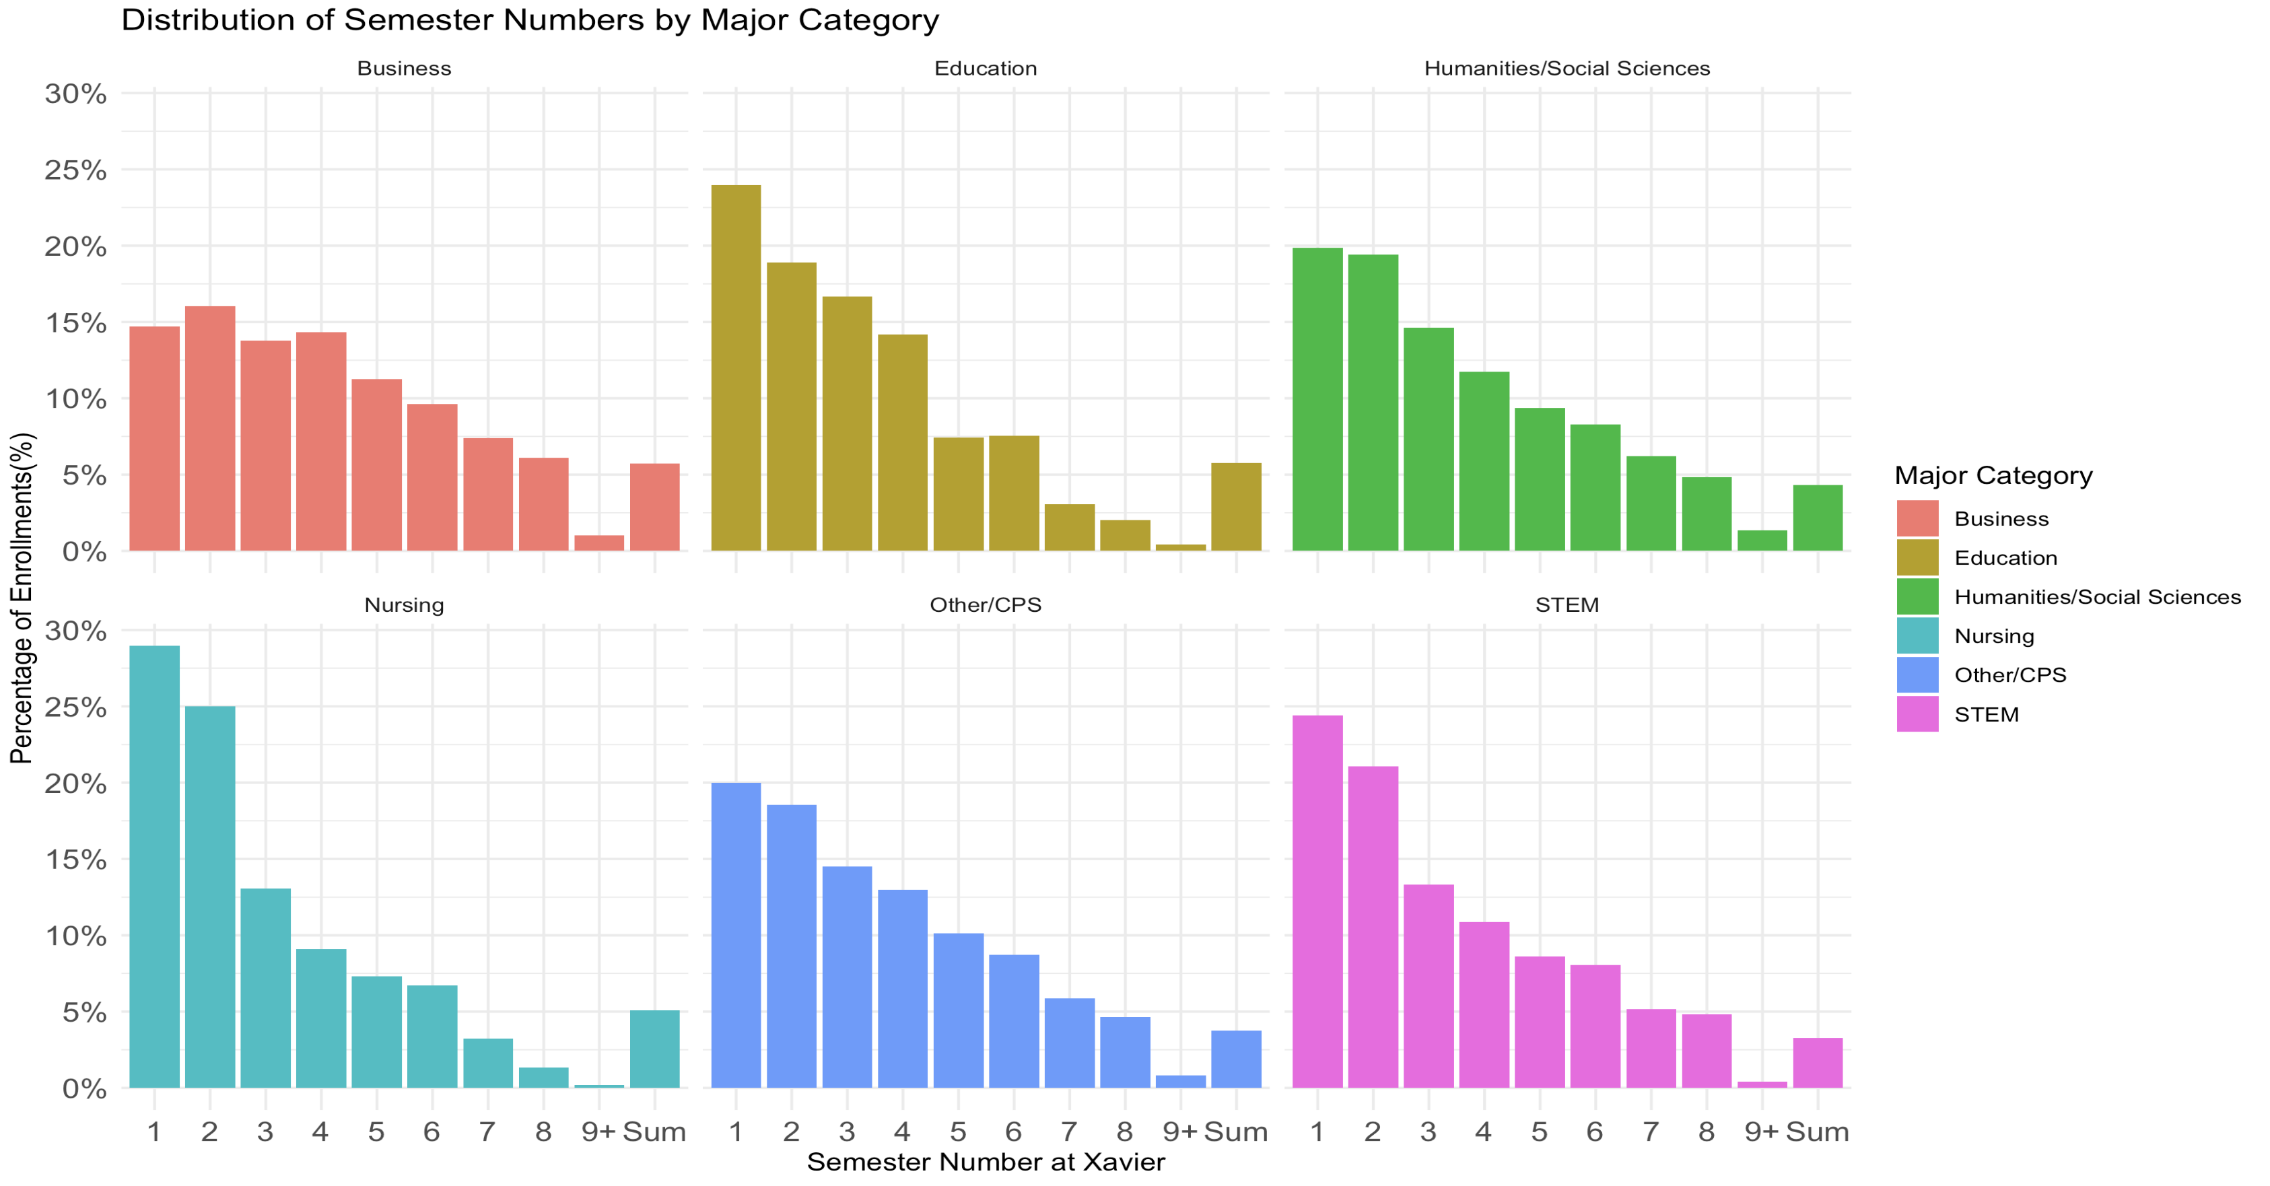
Overall core class timing, by major group
Nursing, Education take core earlier; Business spreads out the core
Notes:
No at xavier
Percentage of enrollment
Add findings/ what you want to say

Slide 11
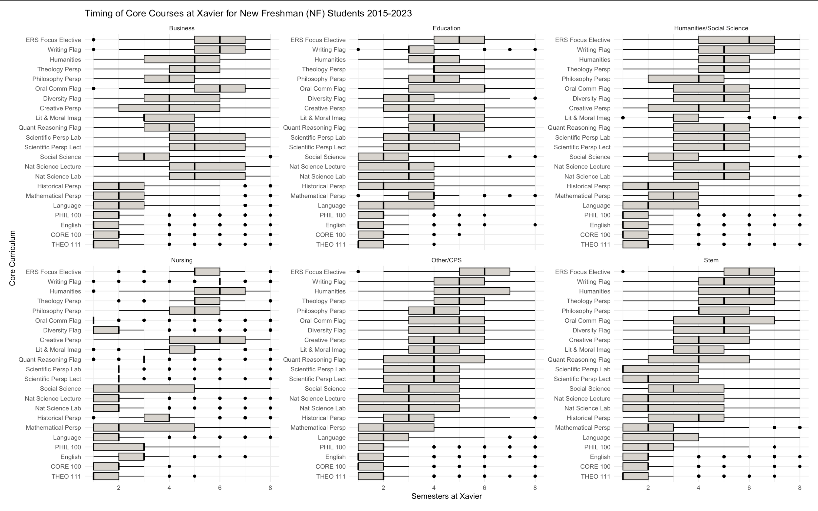

Slide 12
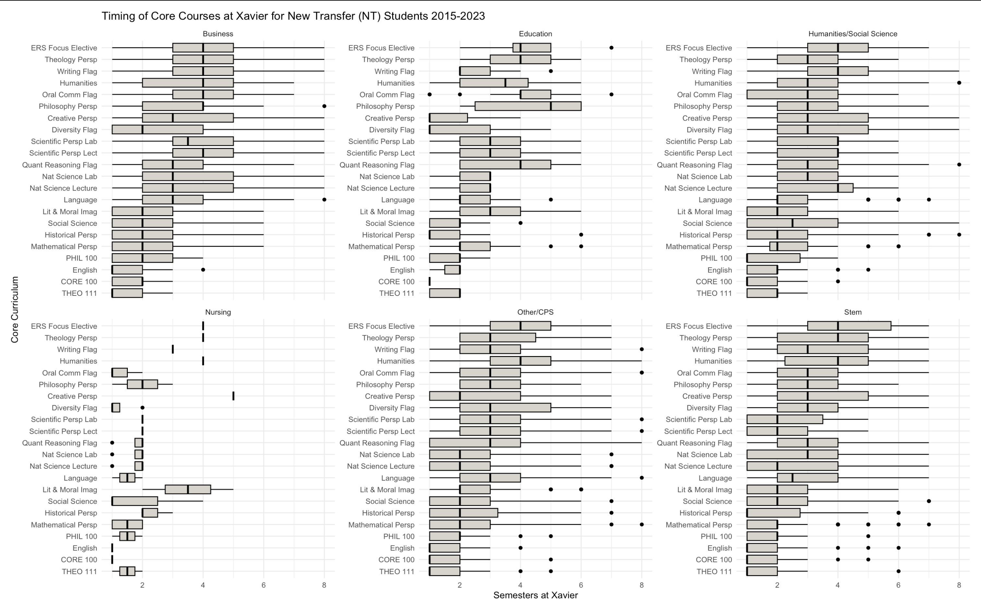

Slide 13
Back to Summer
What classes are taken the most during the summer?
Is there a difference between New Freshmen and New Transfers?

Slide 14
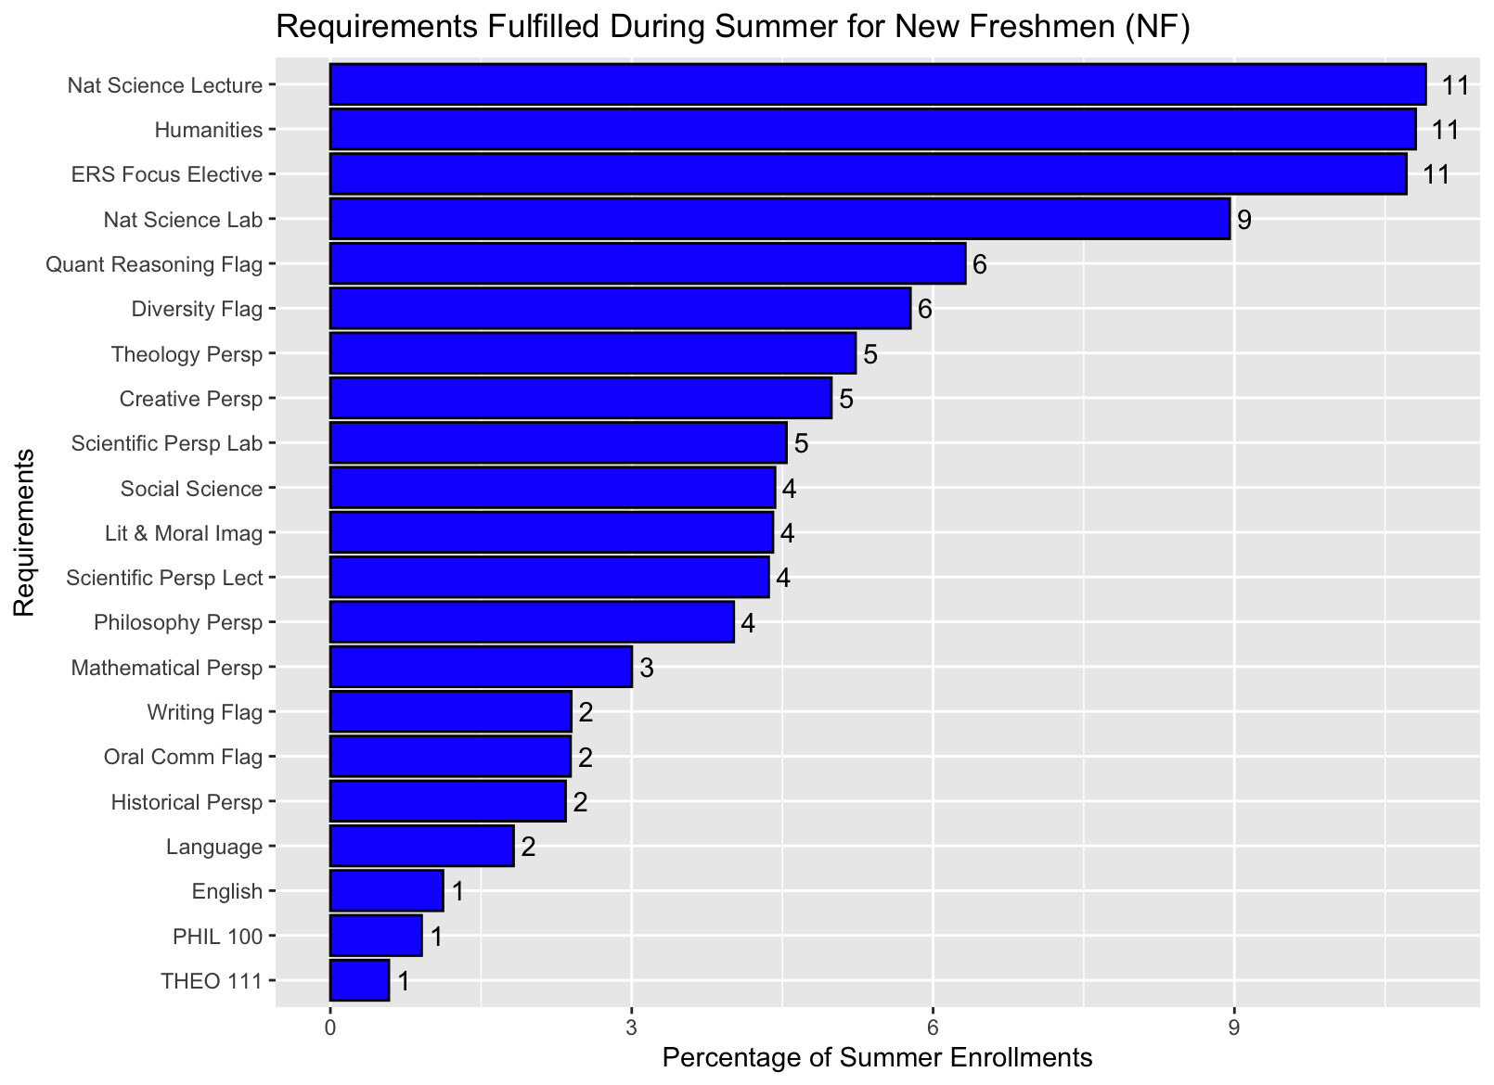
Notes:
Percentage of total summer enrollments
Address percentages (rounded to nearest whole number)
Why certain courses have higher vs lower percentages

Slide 15
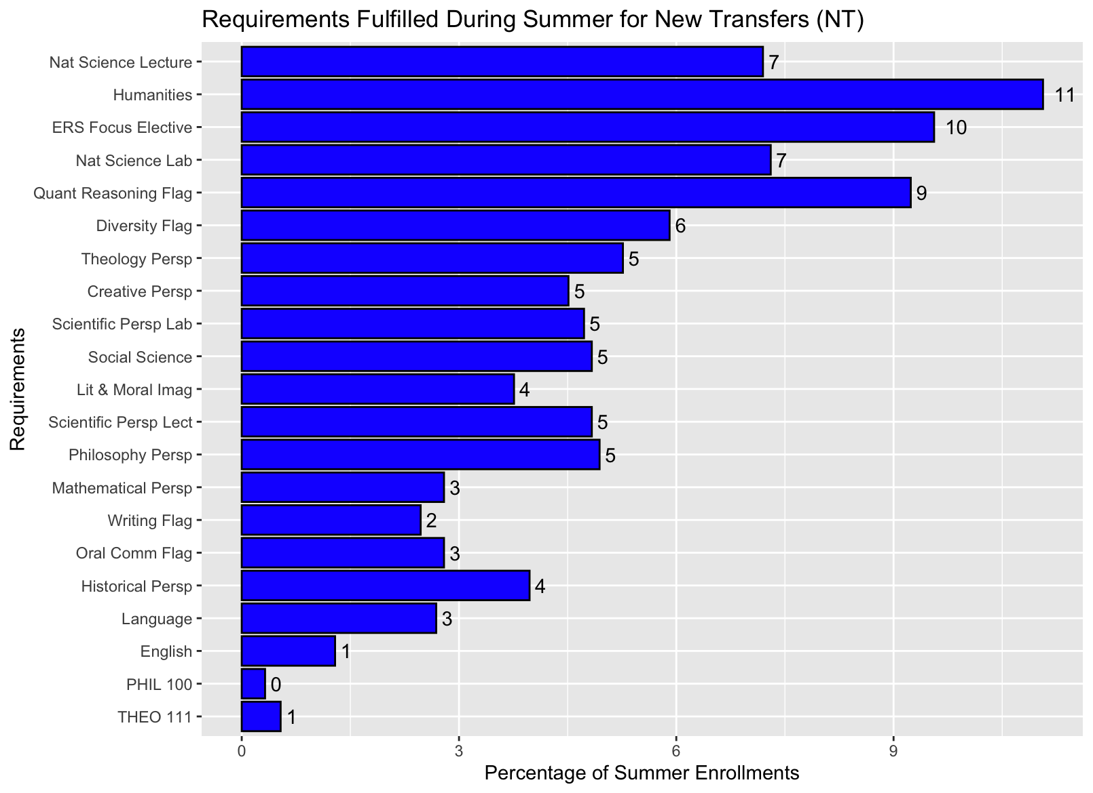
Notes:
What are the largest differences between NF and NT?
Relatively similar, most classes have a 1-2% change (if at all). The two exceptions are Nat Science Lecture which decreases by 4% and Quant Reasoning Flag which increases by 3%

Slide 16
Changing Majors
How does changing majors affect the core experience?

Slide 17
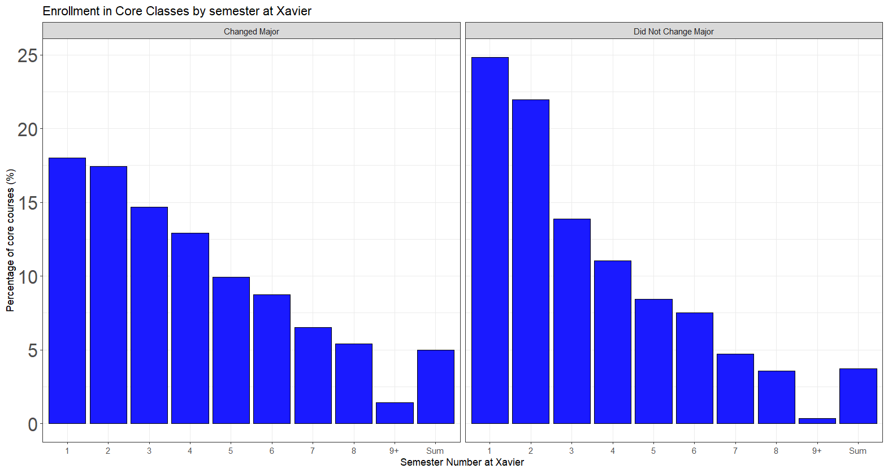
How Changing Majors Affects Core
Major change produces slight delay in core

Slide 18
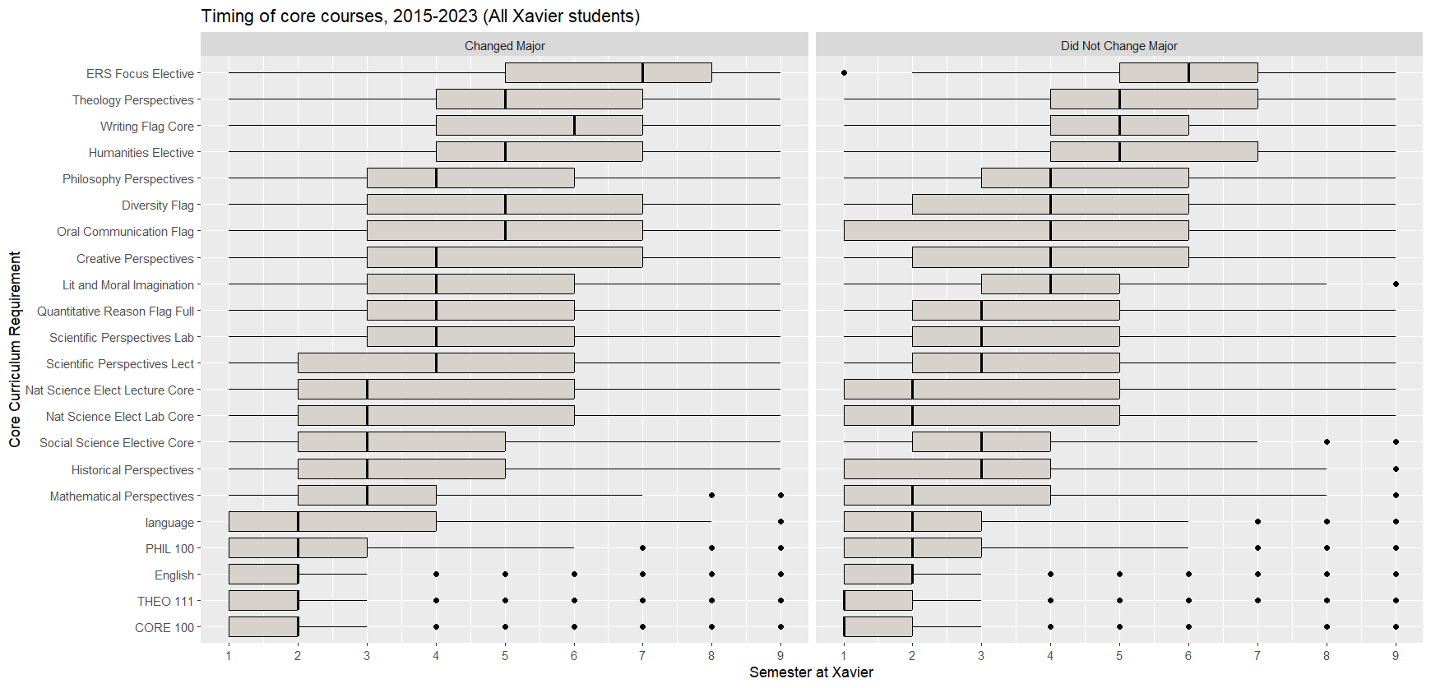
Changing Majors and Timing of the Core
Core completion shifts later slightly with major change

Slide 19
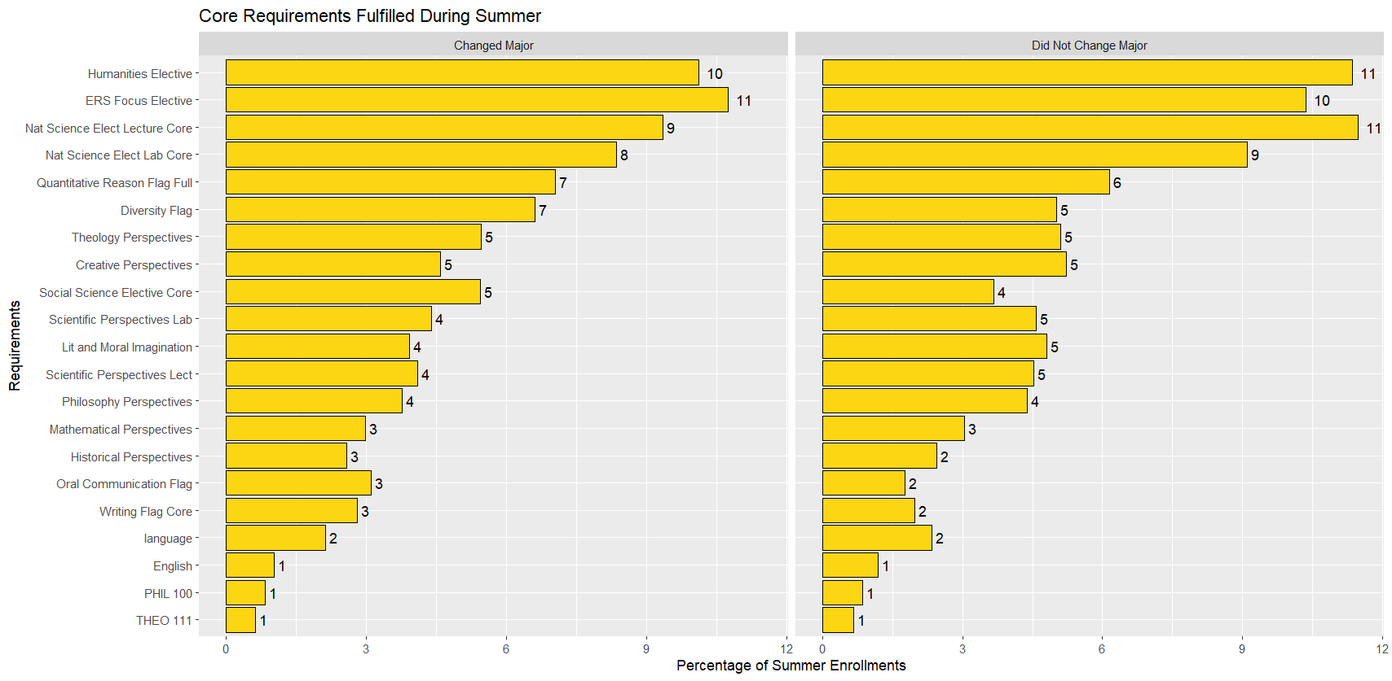
How Changing Majors Affects Core in the Summer
The proportions of students for each requirement does not vary much if a student changes their major
If they change their major there are generally a slightly lower proportion for each requirement

Slide 20
Second Language Requirement
Who tested out of the language requirement?
How do we know who tested out vs. who just didn’t finish the core curriculum?
How many language courses are students taking to reach the required 201-level proficiency?

Slide 21
How did we distinguish between students who finished and those who didn’t?
Filtered data to include only the Student IDs that appeared in a list of students to stayed for 4 years.
If a student is on this list, we assume they graduated.
Two options for any missing requirements:
Transfer credit
Tested out of the requirement

Slide 22
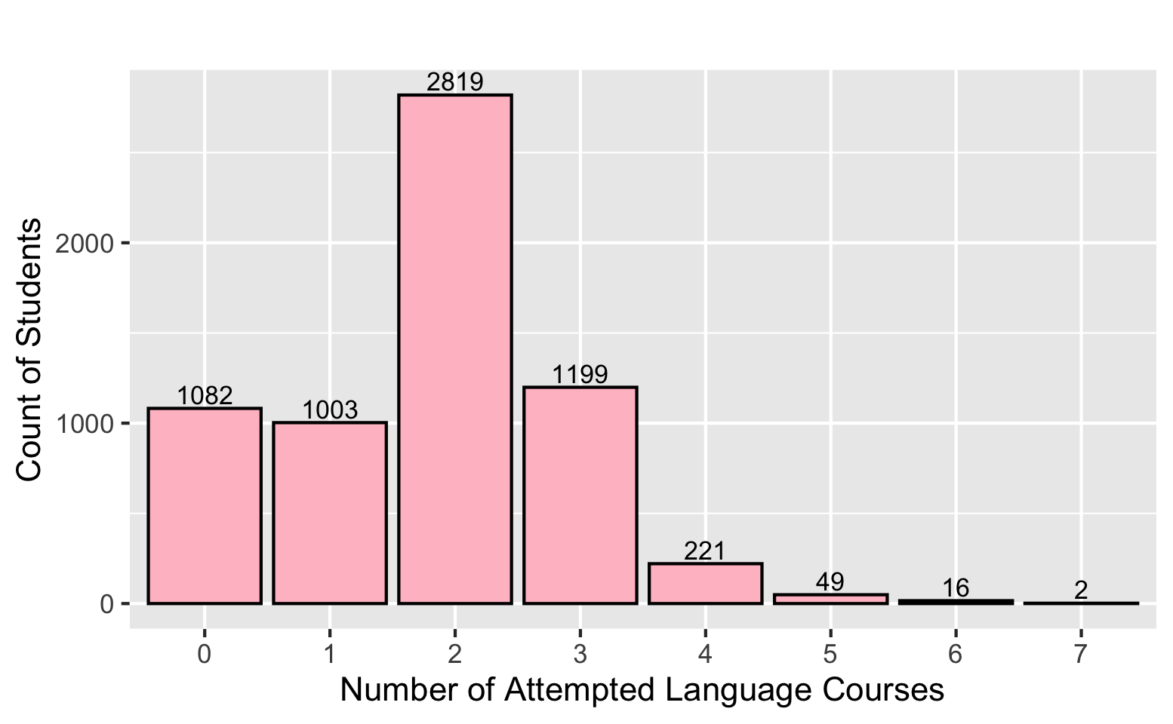
Language Requirements
6391 total students
17% take no language
16% take 1
44% take 2
Average = 2.34 courses to fulfill the second language requirement

Slide 23
Transfer Credit
What courses are students using transfer credits to fulfill?
What does this look like in the data?
Filtered by students who stayed four years at XU
Some requirements were not fulfilled:
Tested out of the course (Second Language requirement)
Transfer credit (AP courses, transferred from community colleges, etc.)

Slide 24
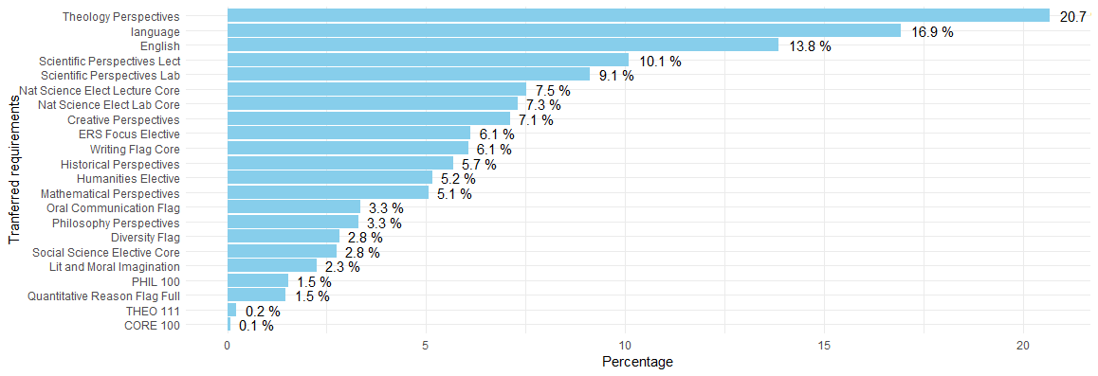
Transfer Credit for CORE requirements
Population of 6391 retained students

Slide 25
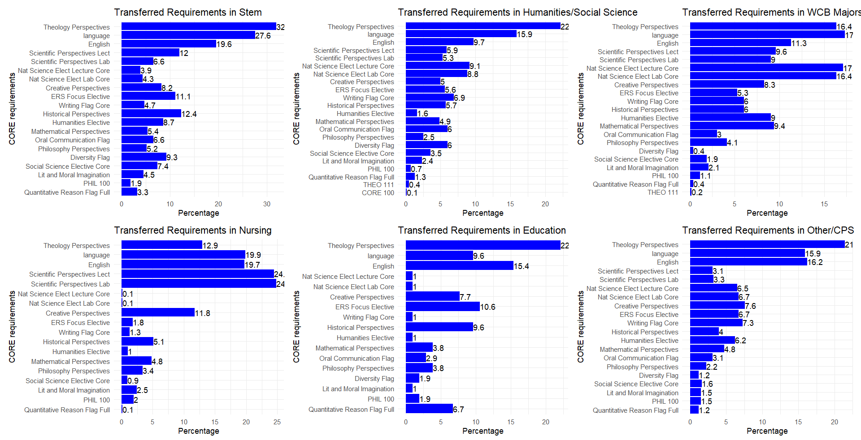
Transfer Credit for CORE requirements by groups of majors

Slide 26
Grades
What does the grade distribution look like for core requirements?
By major grouping?
By each individual core requirement?
Can we see the “easiest” and “hardest” core requirement by GPA and DFW?

Slide 27
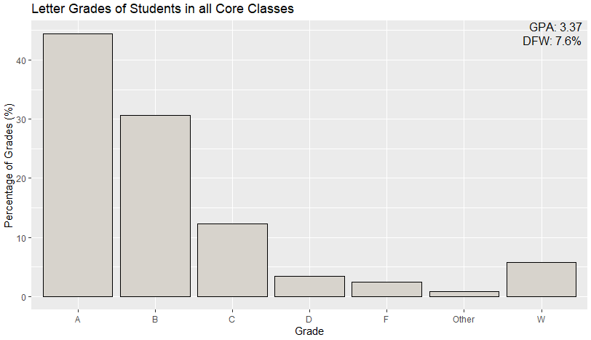
Letter Grades of Students in All Core Courses
New Freshmen
Combined: As, Bs, Cs, Ds, F & VF. These affect GPA.
Other: forms of completion/incompletion that do not affect GPA
Withdrawal: W
Notes:
Other: "I“ = incomplete, "AU“ = audit, "S“ = satisfactory, "NR“ = not reported, "NA“ = ,"IP“ = in progress, "P“ = pass

Slide 28
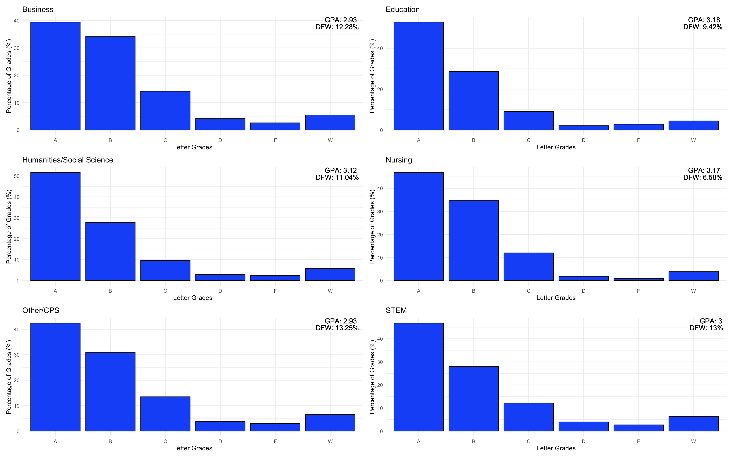
New Freshmen Letter Grades in Core by Major Categories
DFW: Ds, F, VF, & W.
Poor or inadequate
attempts at core
requirement
completion.
Notes:
-Why is Nursing more successful?
45% of the Core (highest among major categories) (advantage of only having one major) is met by the Nursing major and thus have the advantage of being in their "wheelhouse" more often, rather than just taking a bunch of classes that don't apply or interest them (some random philosophy class)
-Education is very similar as well
-Less successful categories are the opposite

Slide 29
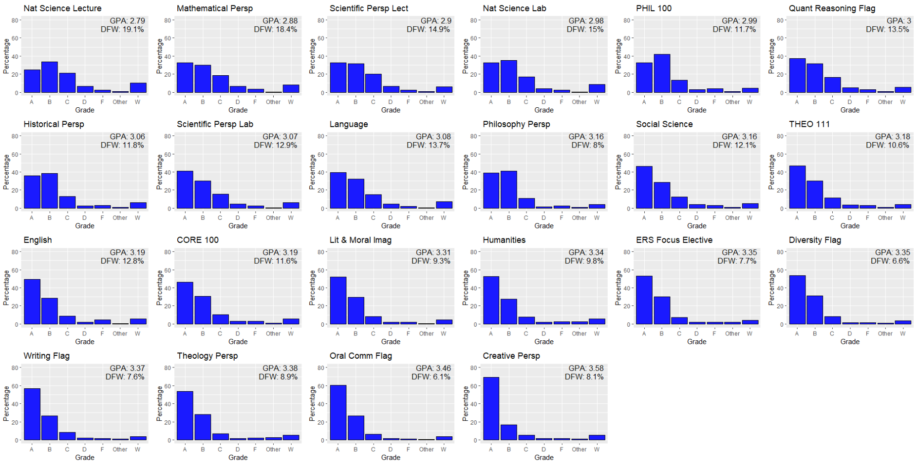
Letter Grades by Each Individual Core Requirement
Ordered by lowest to highest GPA
Filtered by New Freshmen
Notes:
Things to point out:
Creative Perspectives is the “easiest”
The 4 lowest overall GPAs are STEM core requirements
Even though philosophy perspectives is in the lower half of the GPA distribution, its DFW is amongst the lowest.

Slide 30
Core/Major Overlap
How much of the core is fulfilled by each major?
How many majors fulfill each requirement of the core?
What exactly are we looking at?
22 Core requirements
62 Majors with available data

Slide 31
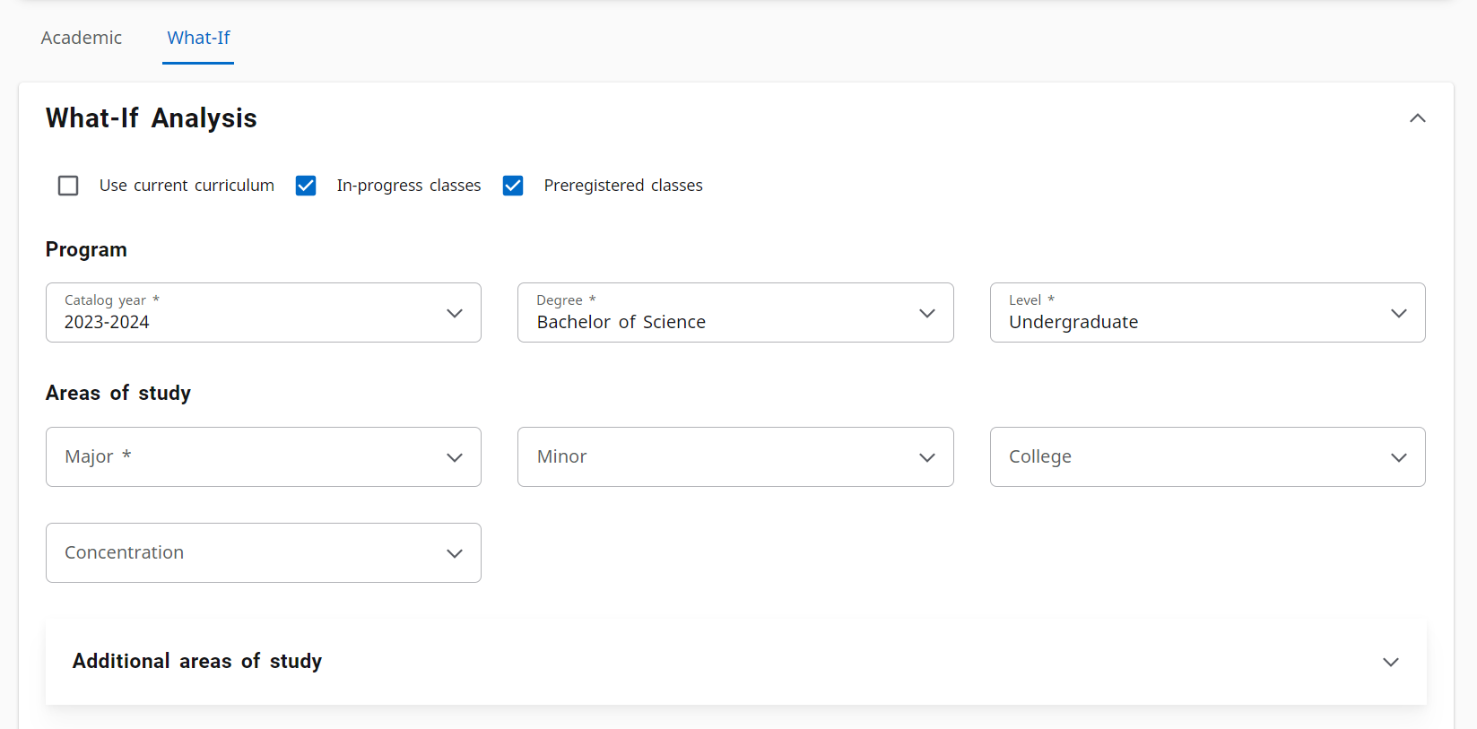
Method

Slide 32
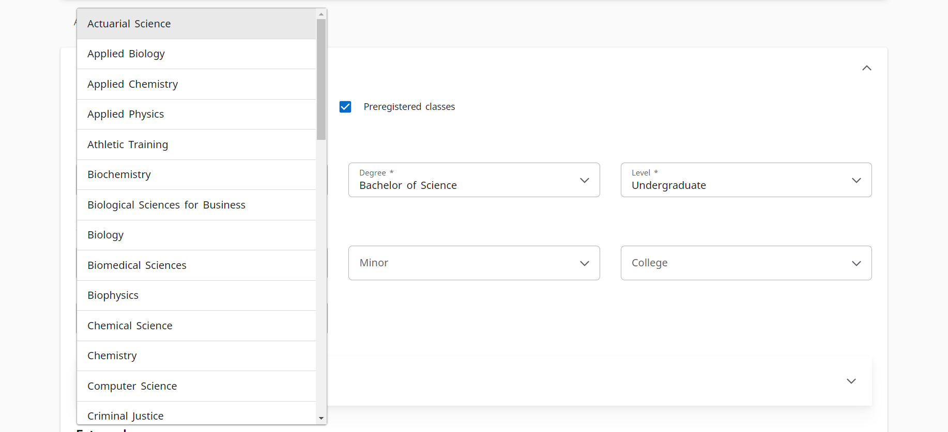
Method

Slide 33
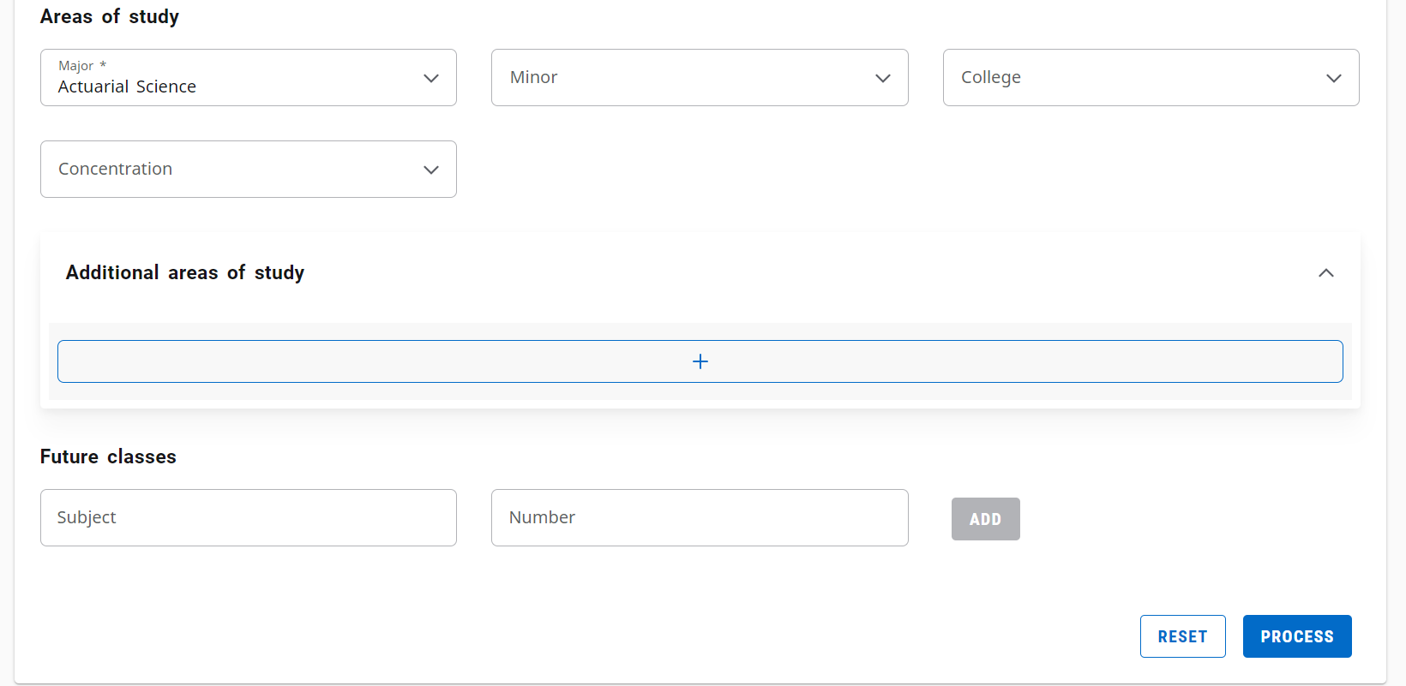
Method

Slide 34
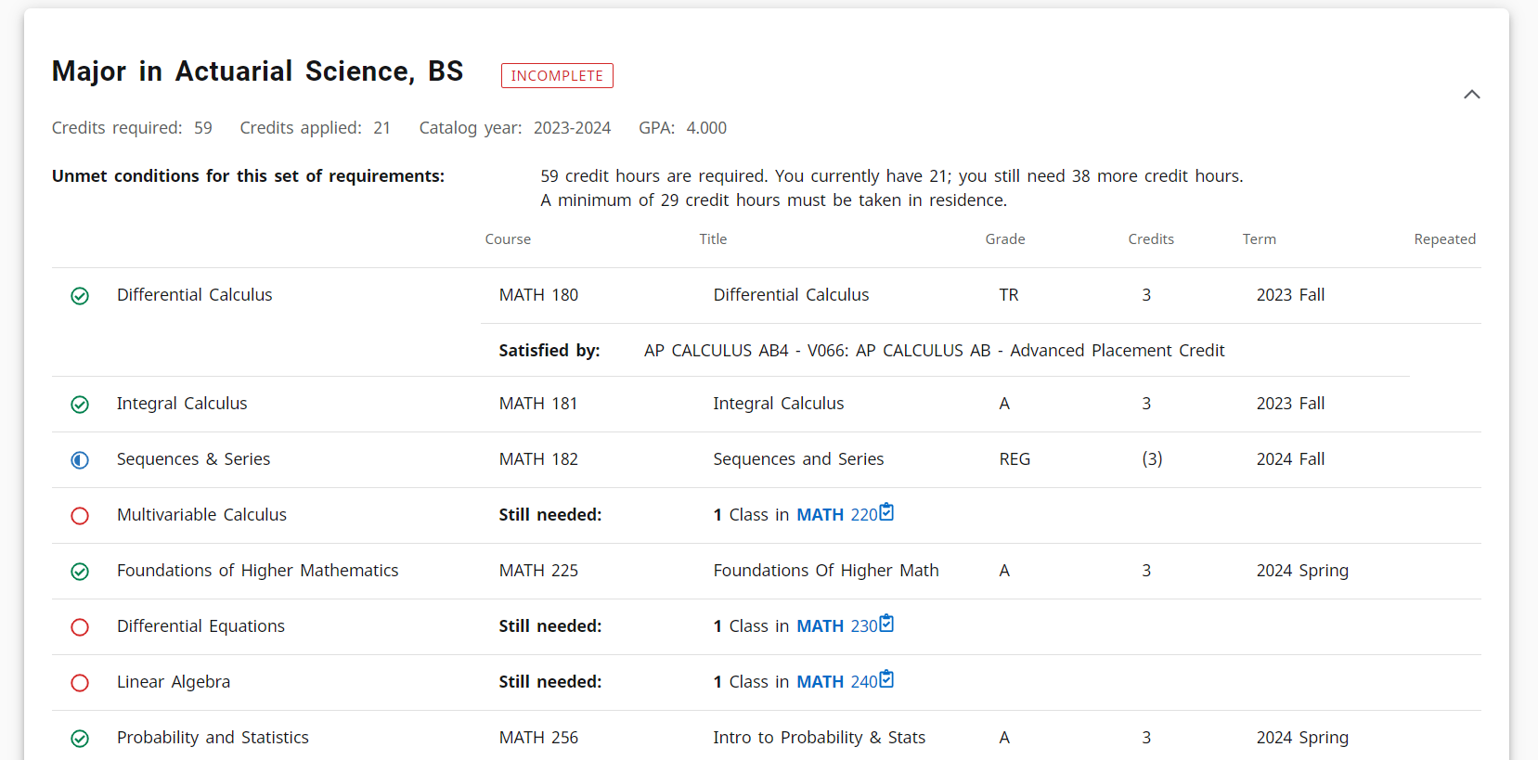


Method

Slide 35
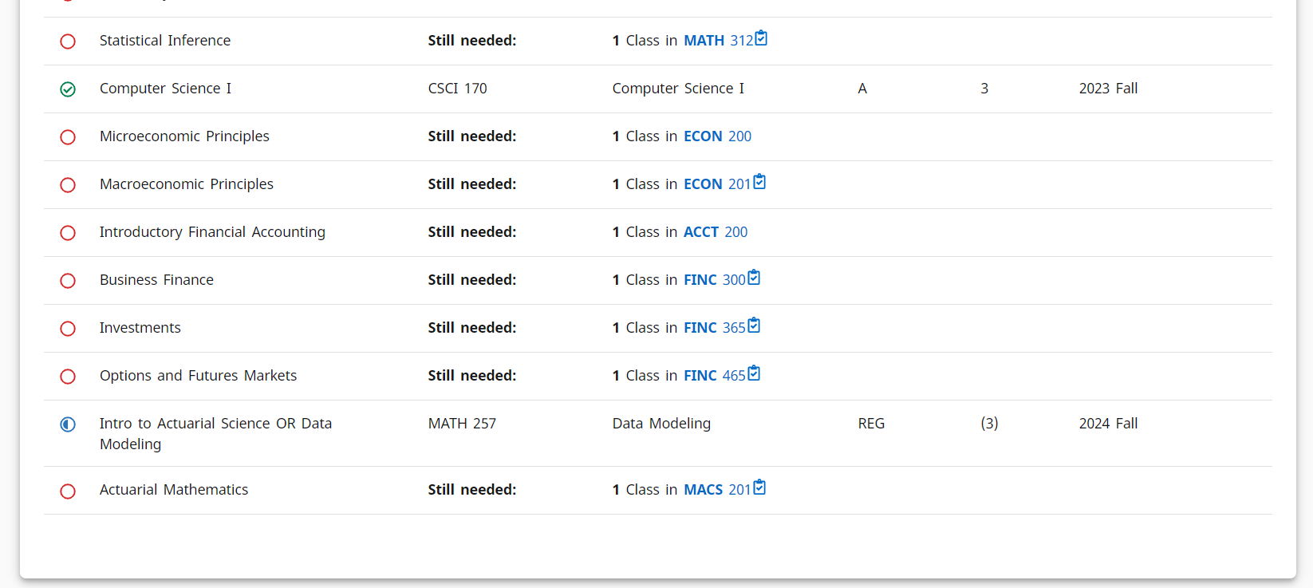
Method

Slide 36
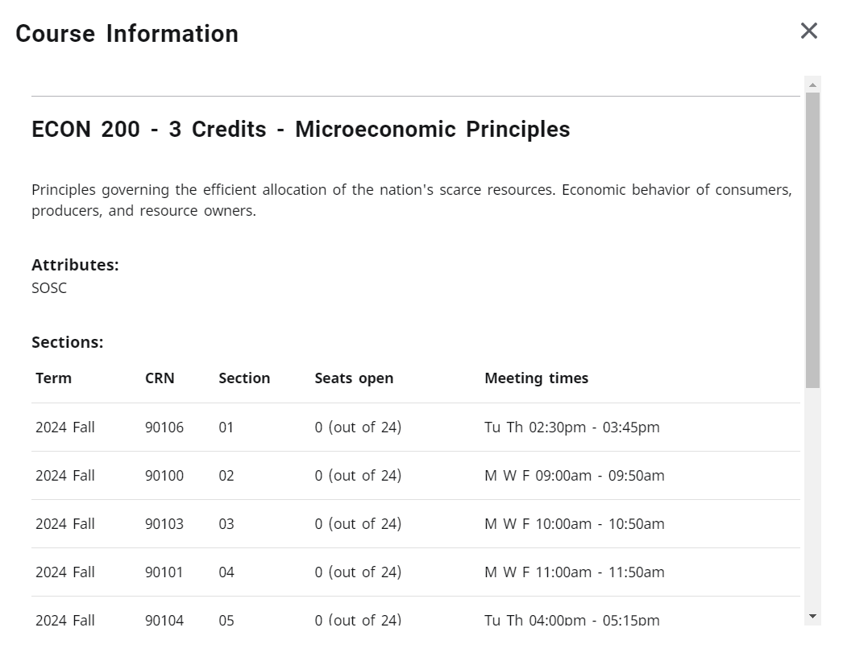
Method

Slide 37
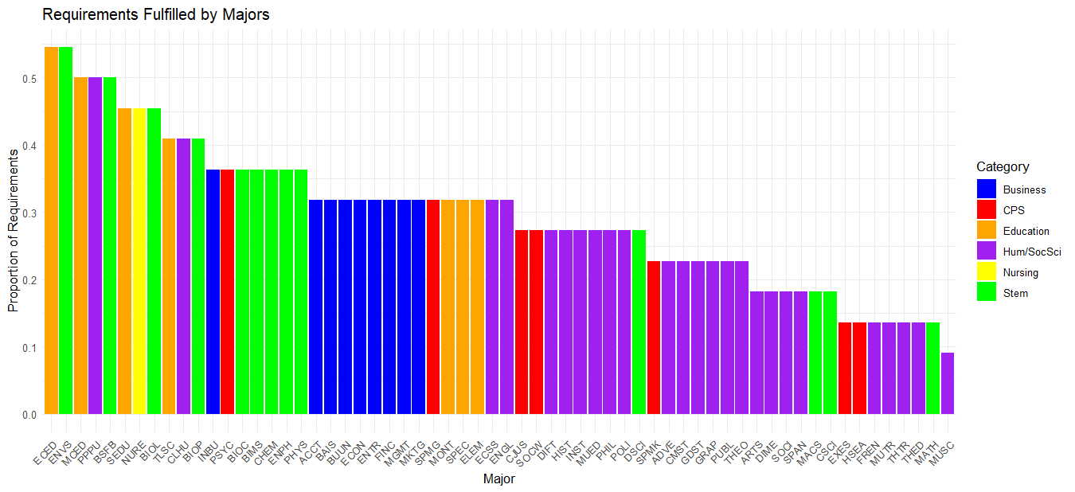
How Much of the Core is Fulfilled by Each Major?
Business majors are almost all the same.
Natural science majors fulfill their 4 science requirements in their core.

Slide 38
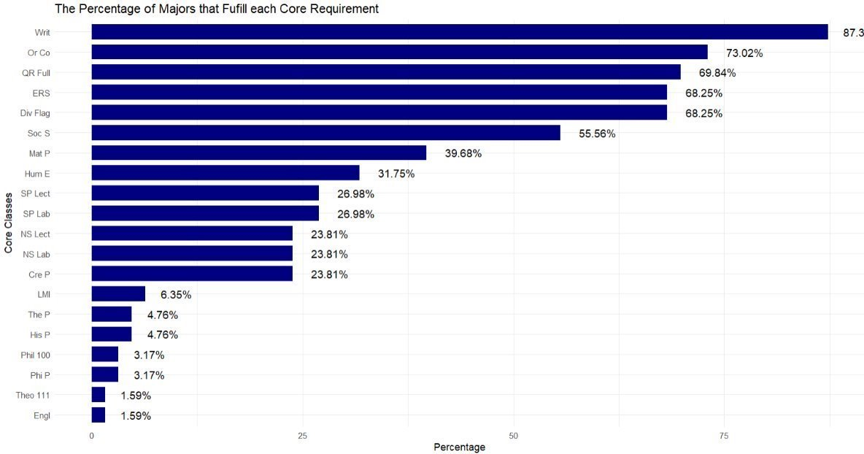
Percent of Majors Fulfill Each Core Requirement
There are more flags required within majors than electives

Slide 39
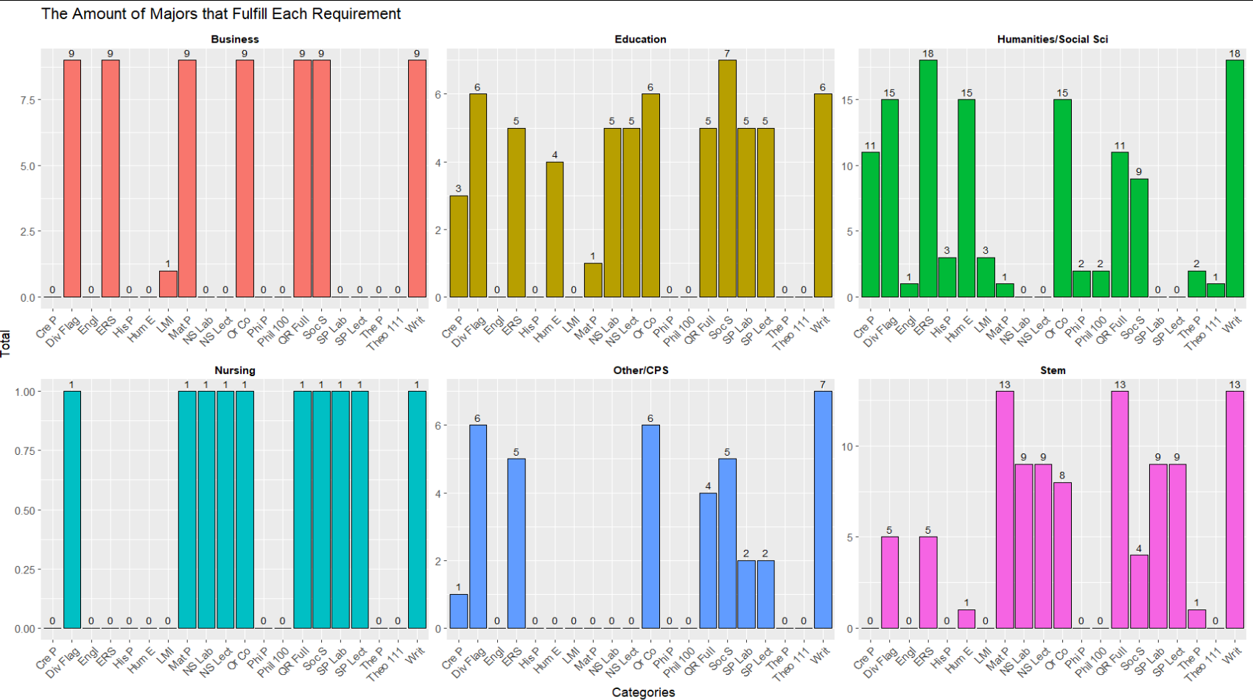
How Many Majors Fulfill Each Requirement?
Most majors fulfill the Writing Flag.
No majors fulfill the language requirement.

Slide 40
Conclusions
Little variation in the way Business students experience the Core
Overall, 3.37 GPA (7.6% DFW) in Xavier's Core Curriculum
Xavier students take an average of 2.34 courses to fulfill Second Language requirement
Large overlap of Nursing, Education majors and the Core
Smaller overlap between Humanities, Social Sciences majors
Changing majors has little impact on the core
HIRE US TO EXPLORE MORE!!!

